Slide 1
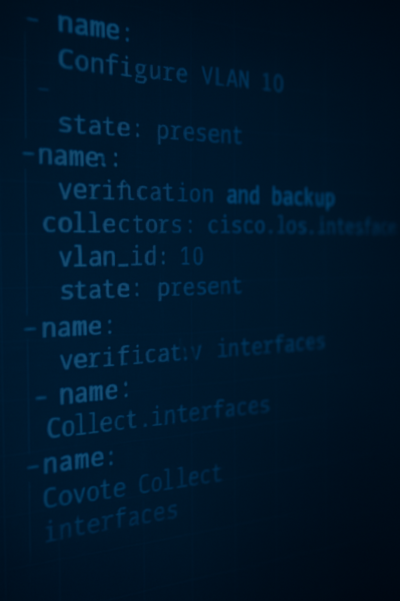
CNIT 381 Final Project
Chad Schertz and Drew Albert

Slide 2
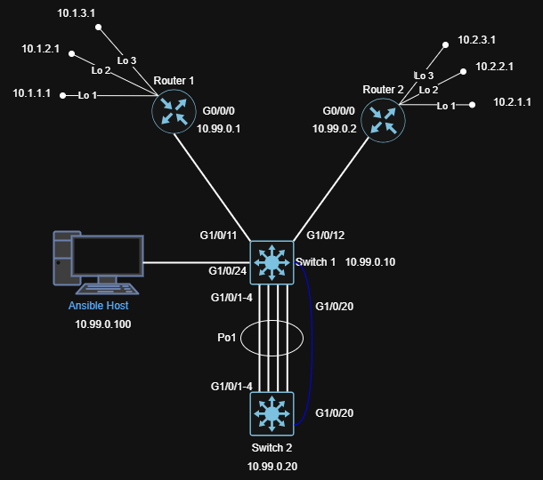

Slide 3
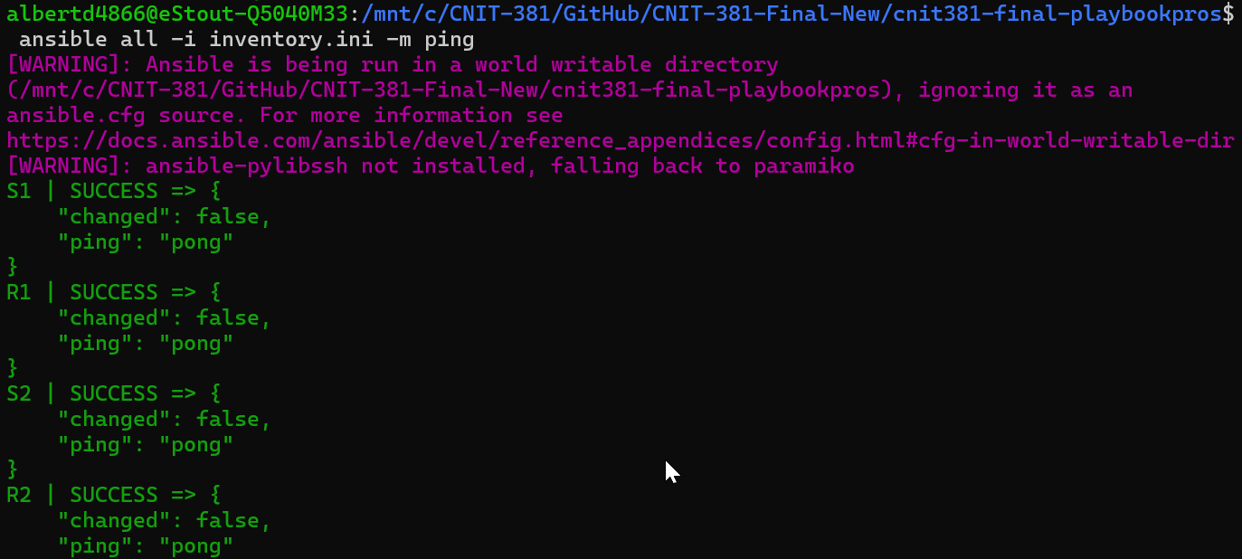

Initial Test

Slide 4
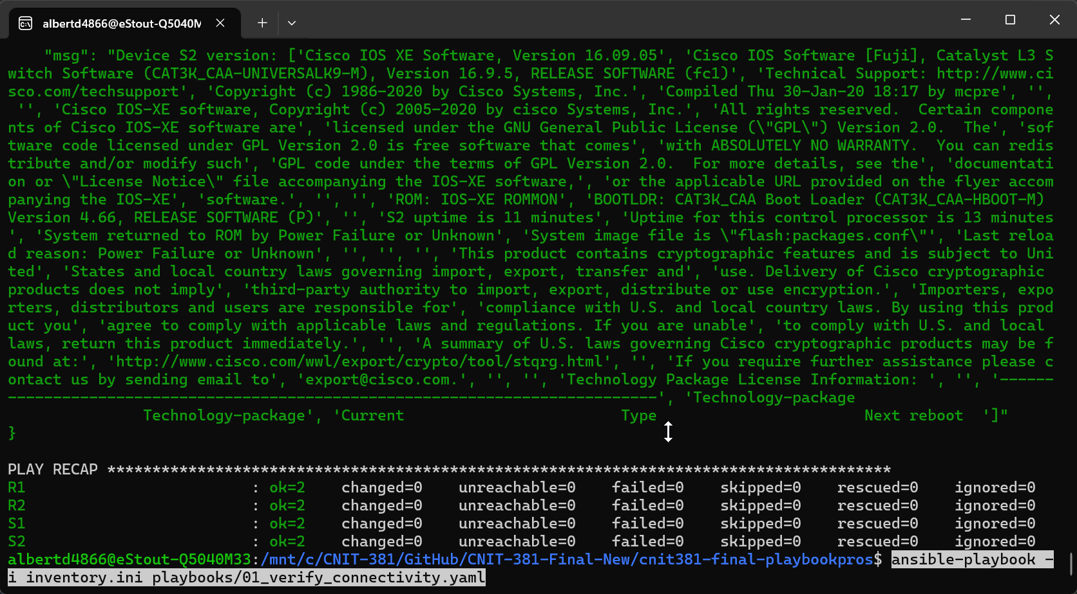
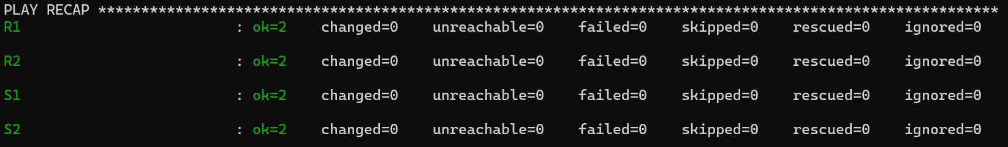
Playbook 1 – Verify Connectivity
This playbook verifies connectivity to the devices specified in the inventory.ini file by printing out its show version information to the console.

Slide 5
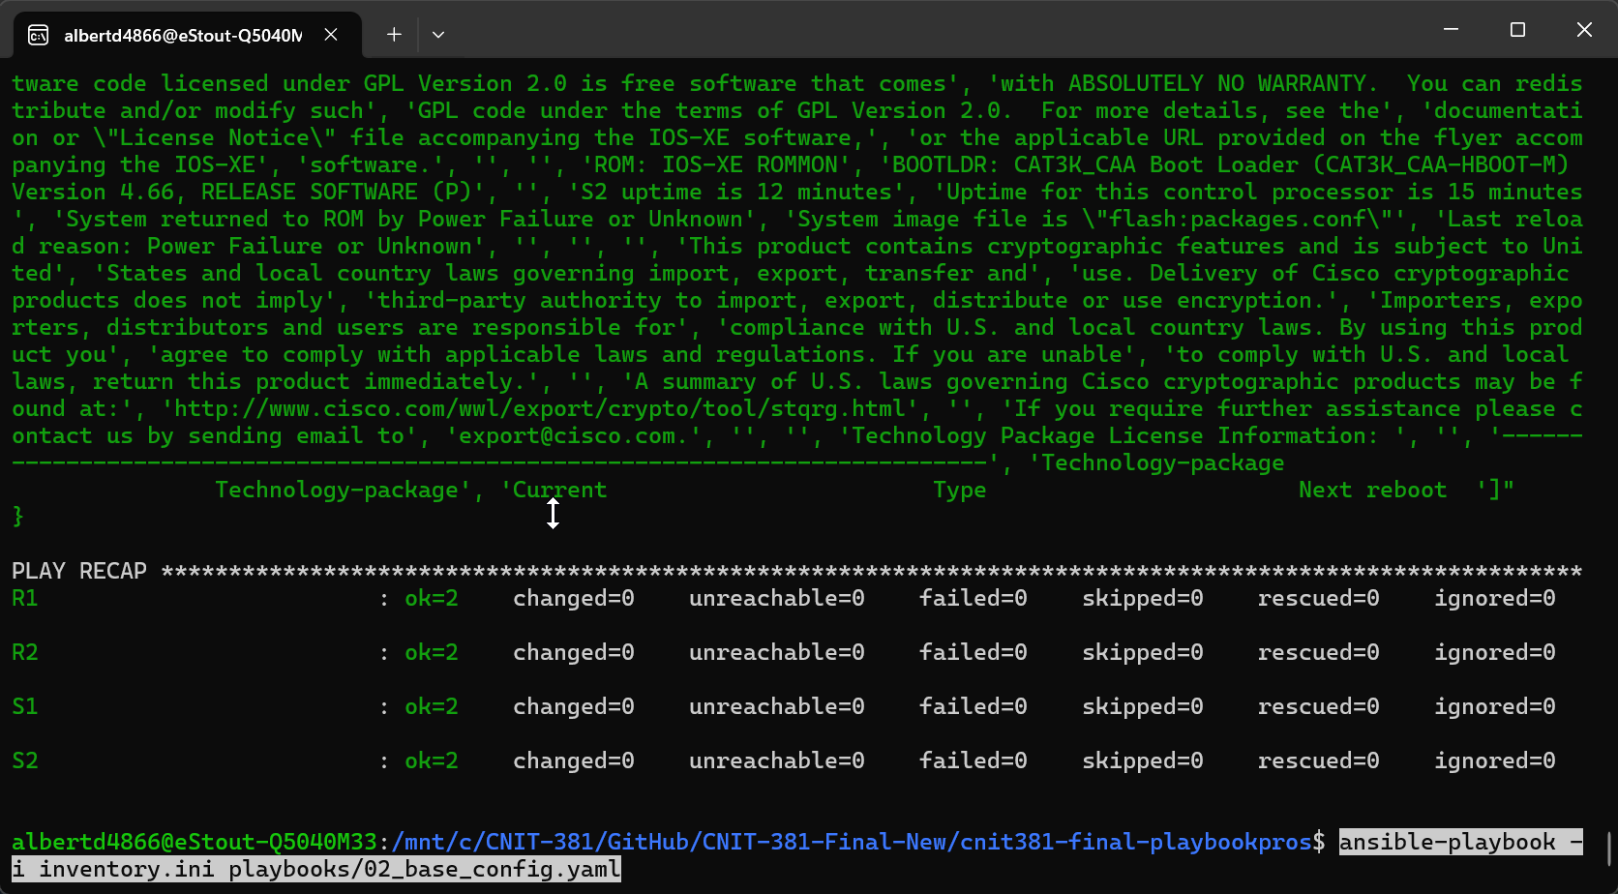
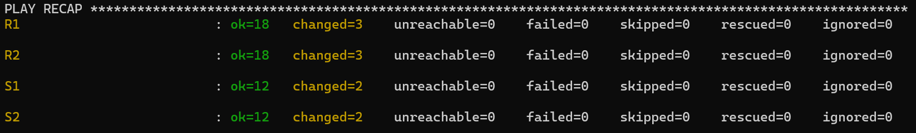
Playbook 2 – Base Configuration
This playbook updates the hostname with the device hostname variable specified in the inventory.ini file, configures interface descriptions as defined in the inventory.ini file, and sets message of the day login banners on all devices.

Slide 6
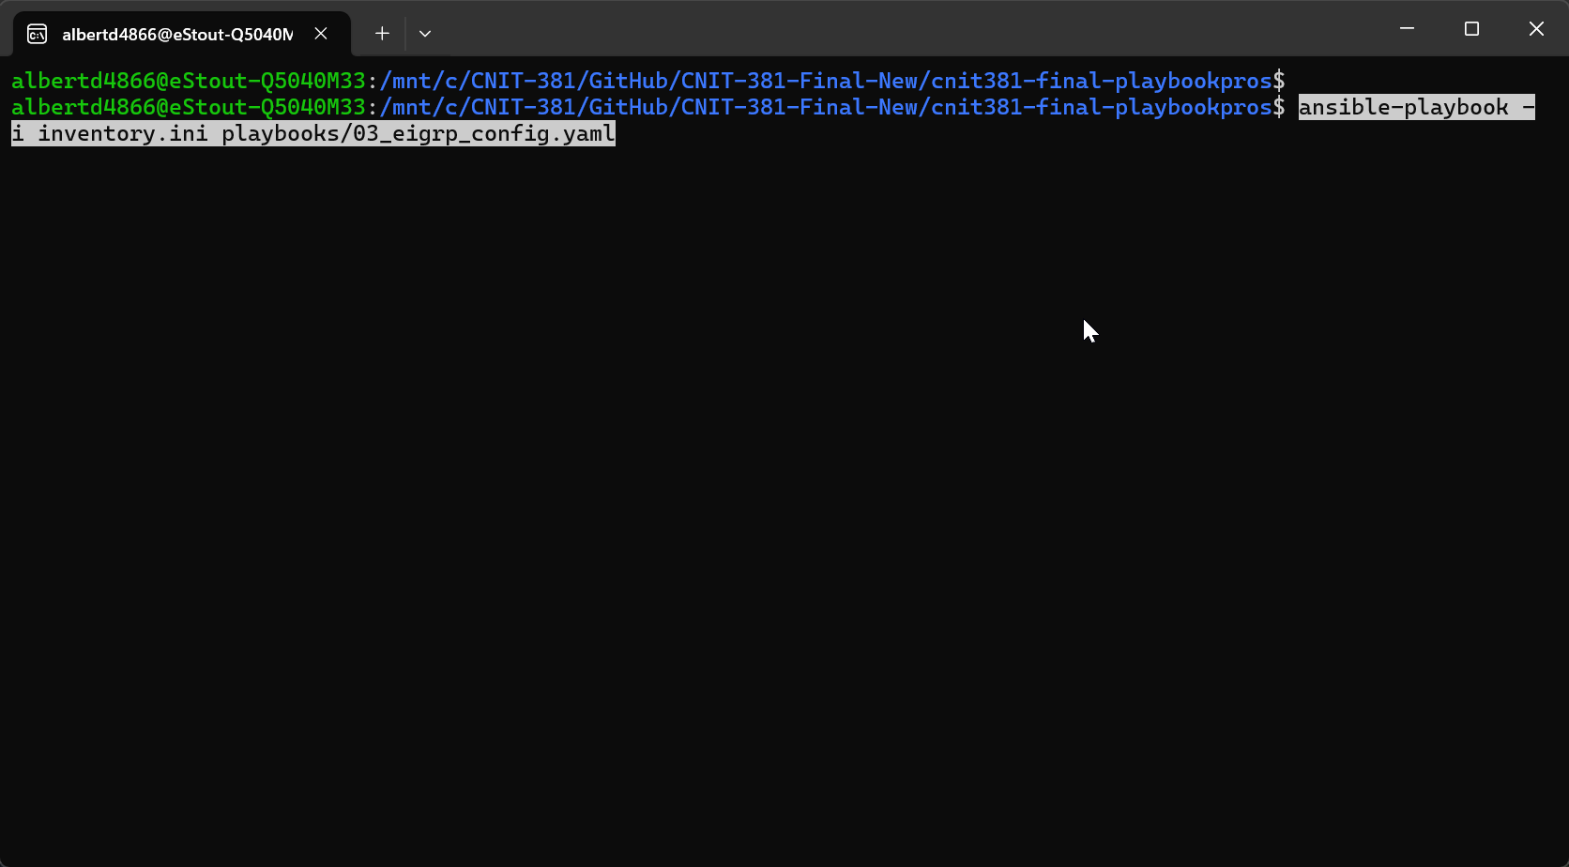
Playbook 3 – EIGRP Configuration
This playbook configures an additional 3 loopback interfaces on the router and then configures EIGRP in AS 100 for the routers.

Slide 7

Playbook 4 – VLAN Configuration
This playbook configures VLANs as specified in the inventory.ini file.

Slide 8
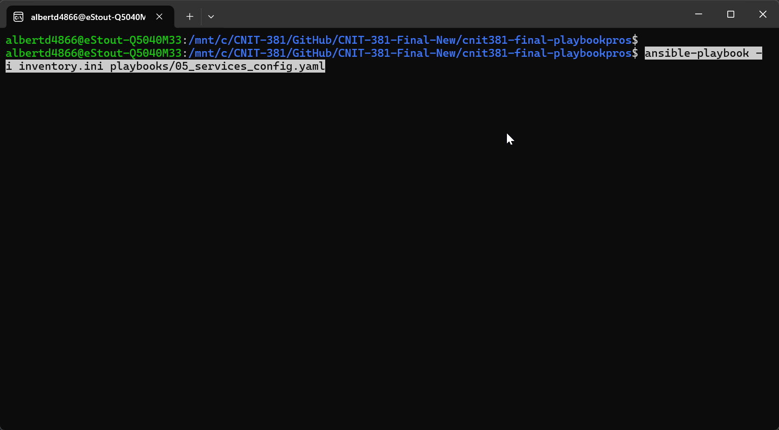
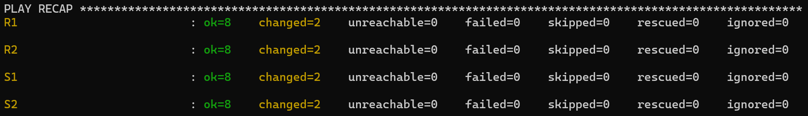
Playbook 5 – Services Configuration
This playbook configures basic NTP server information and configures logging on each of the devices.

Slide 9
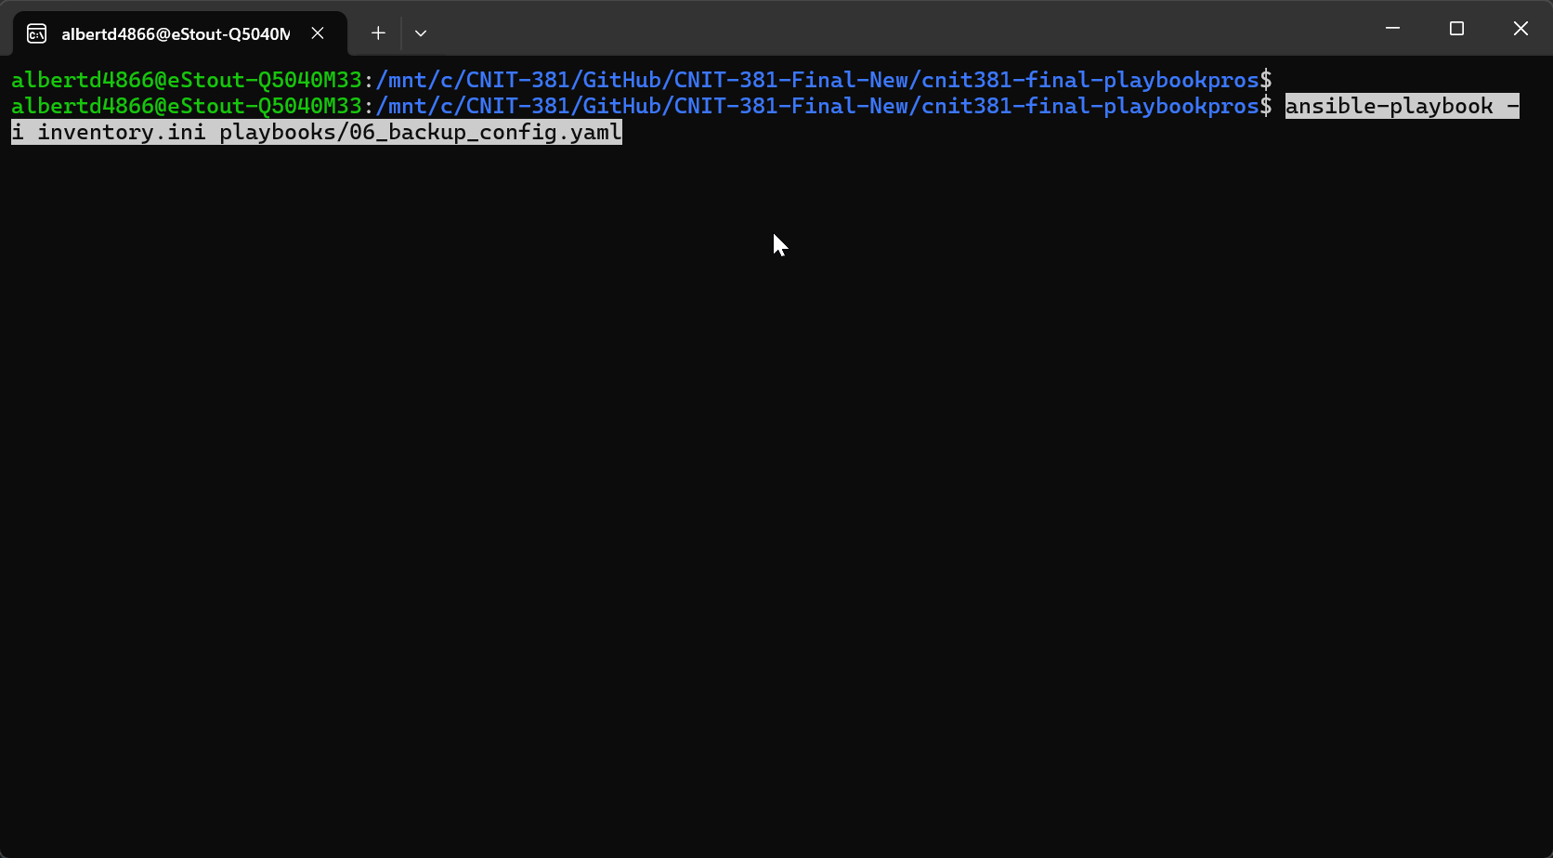
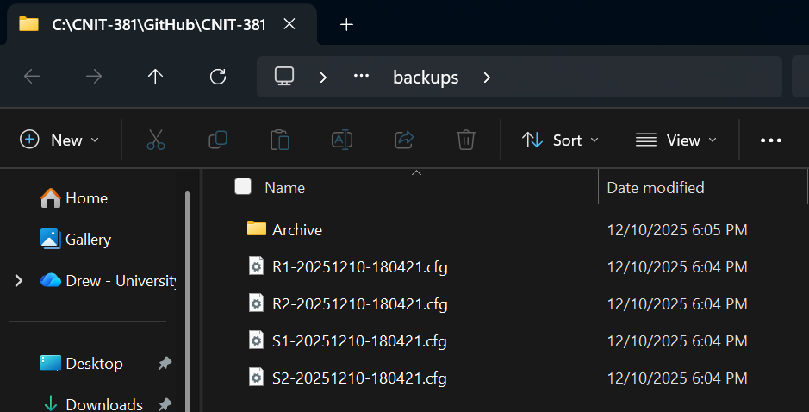
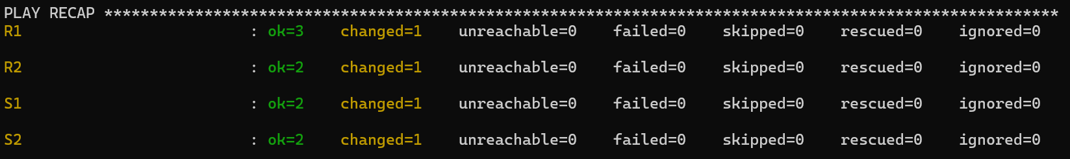
Playbook 6 - Backups
This playbook runs the show running-configuration command on all devices in the inventory.ini file and saves this output to the backups/ directory, with the date and time appended to the configuration file's name.

Slide 10
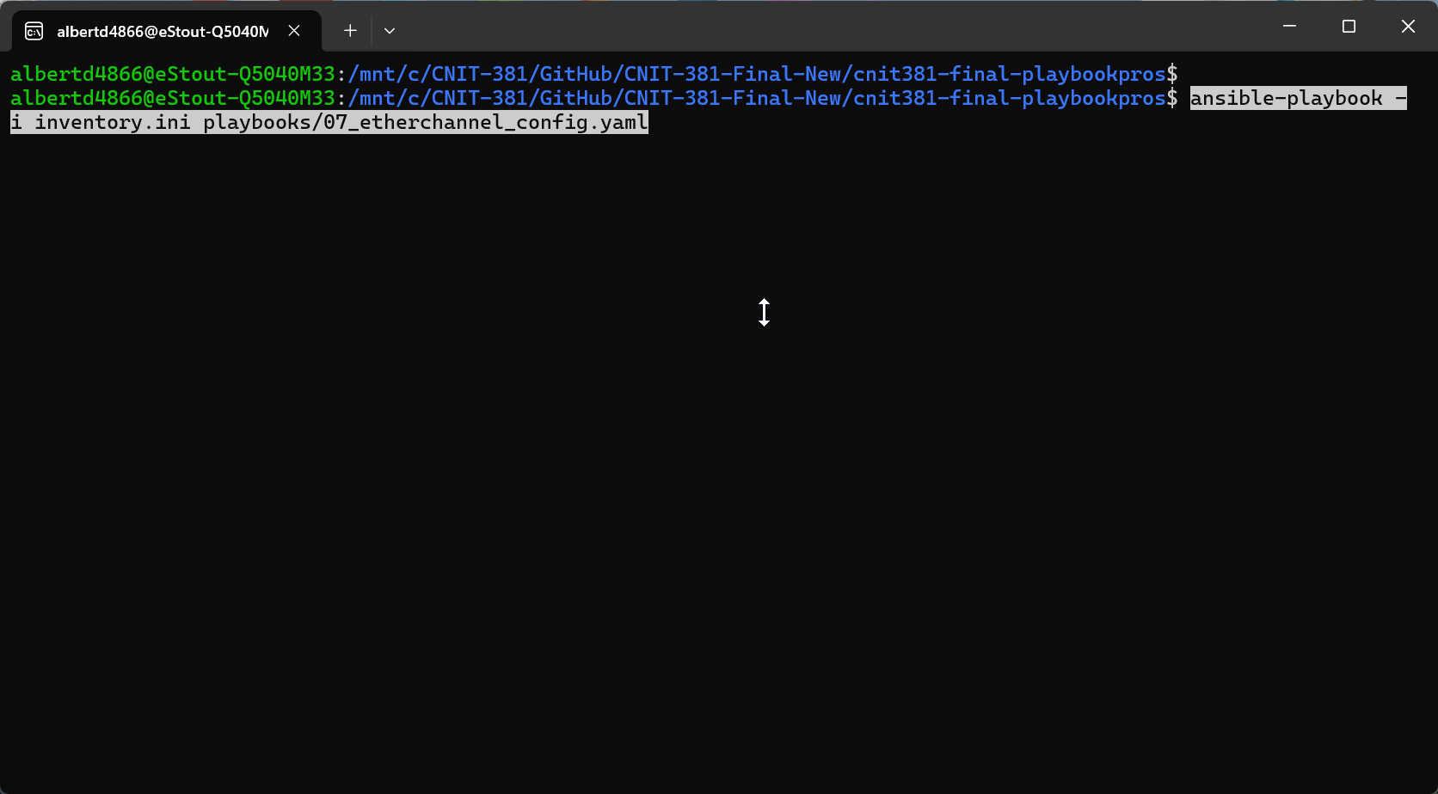
Playbook 7 – EtherChannel Configuration
This playbook automates LACP EtherChannel configuration for the interfaces specified in the inventory.ini file. It also configures Port-channel1 as a trunk port and adds Native VLAN information.

Slide 11
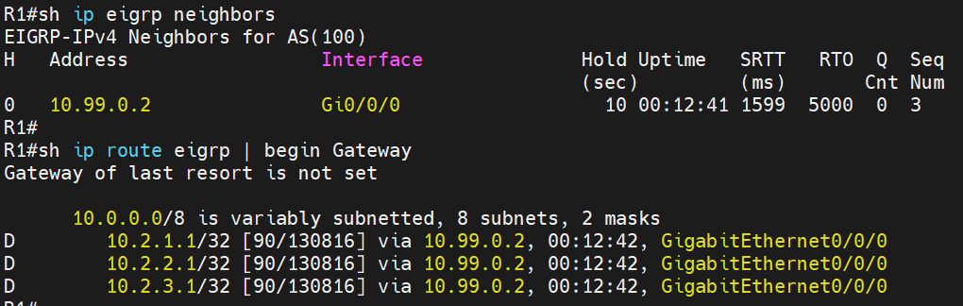
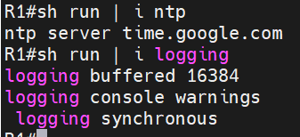
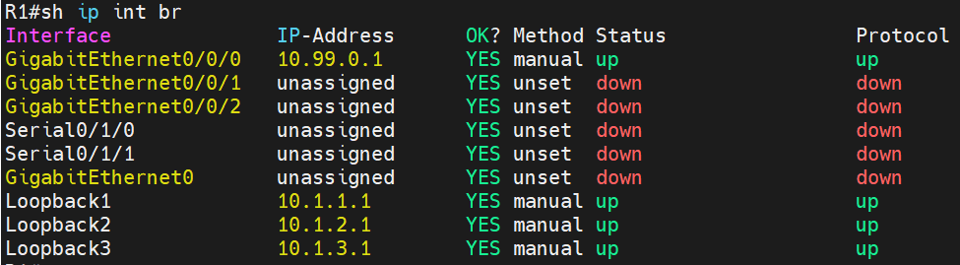
Verification Commands – R1

Slide 12
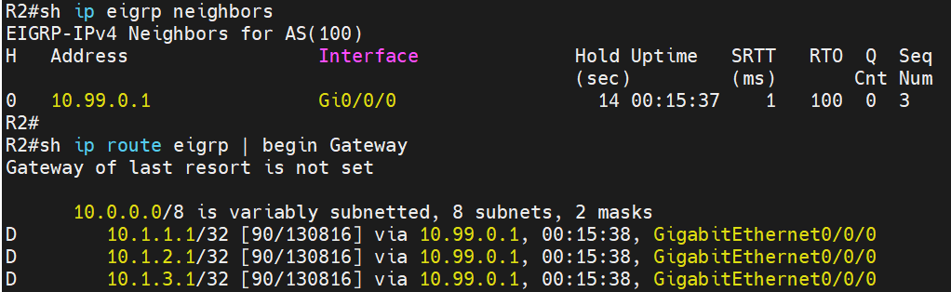
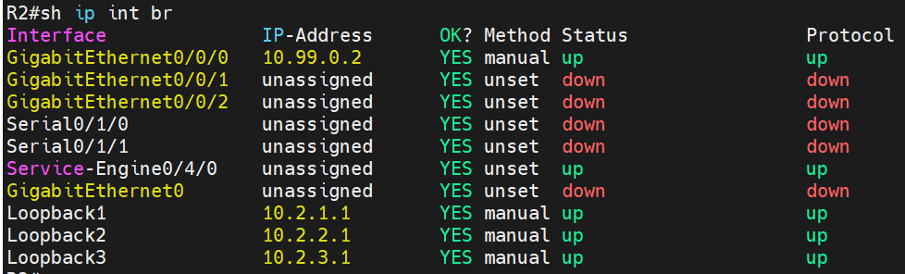
Verification Commands – R2

Slide 13
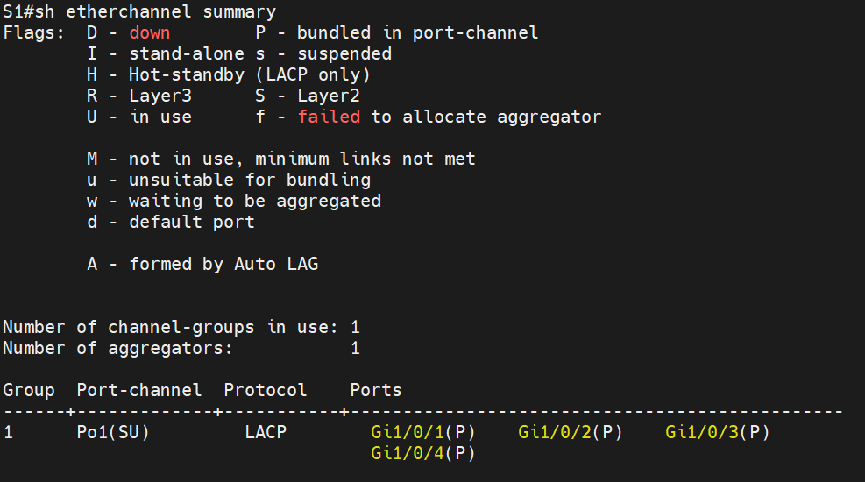
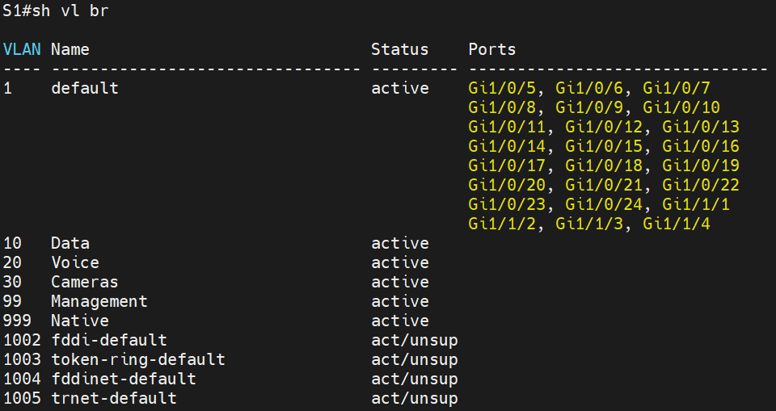
Verification Commands – S1

Slide 14
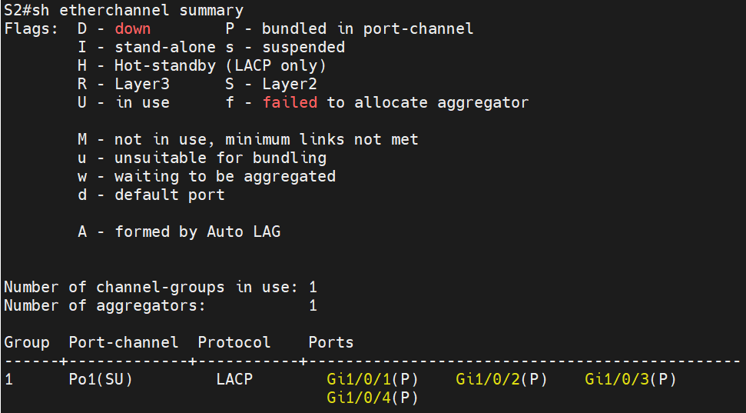
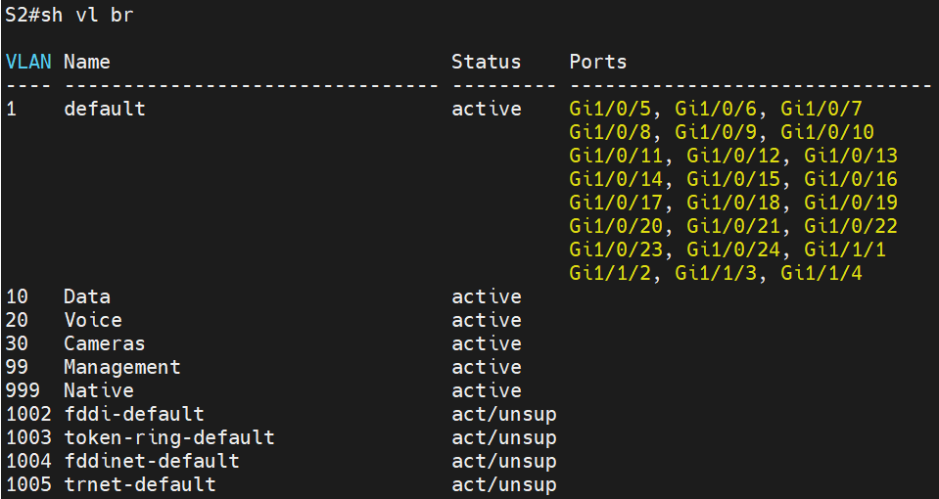
Verification Commands – S2

Slide 15
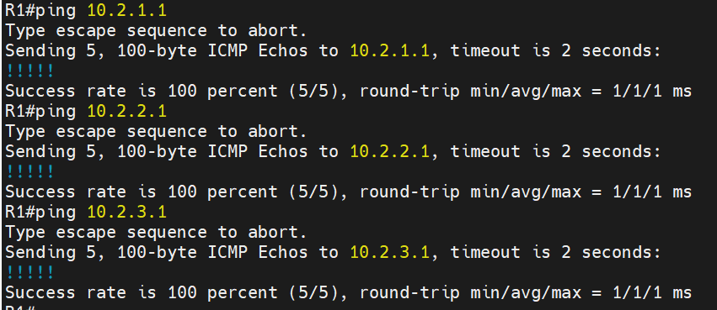
Router to Router Connectivity

Slide 16
Lessons Learned
Small YAML Mistakes Break Everything
Inventory Variables Make Playbooks Scalable
Automating EtherChannel Was More Complex Than Expected

Slide 17
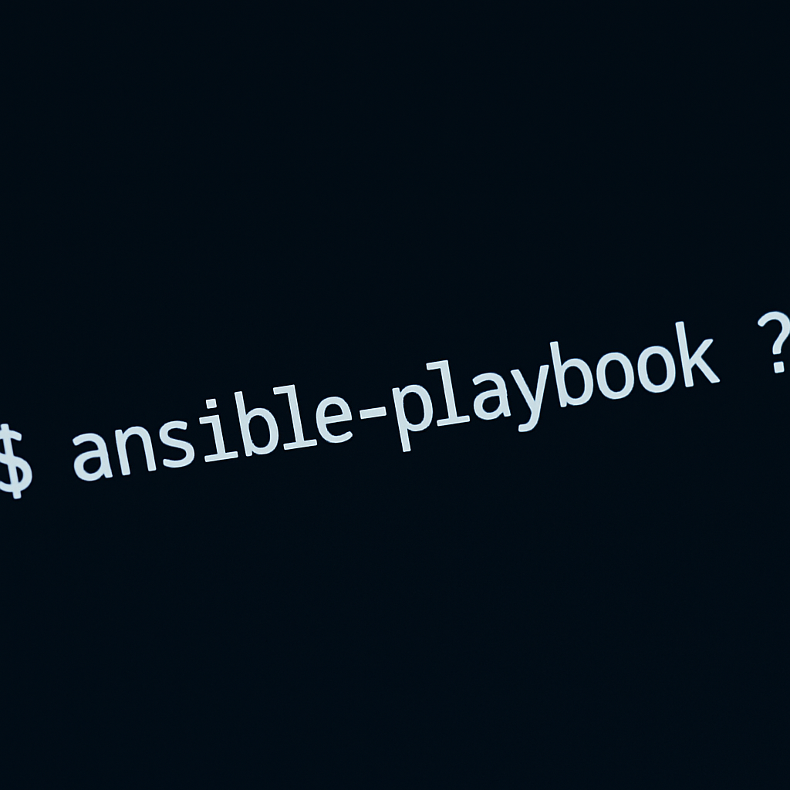
Questions?

